Slide 1

Home Automation System Using Arduino By THE APP WIZARDS
Home automation is computerization of the home, housework or household action.
To construct a wireless home automation system controlled by a smartphone specifically an android device. Our main objectives of the project was to design and implement cost effective home automation system yet an efficient one and a user friendly and a safe system to control home appliances especially aimed to aid the elders and handicapped.
The parts needed for the project are :
• Arduino Uno.
• Proto Board.
• Android phone.
• Bluetooth module (HC-05).
• Some Resistors.
• Jumping Wires.
• Relays Modules.
• Light Bulbs and LEDS
• Portable Fan.

Slide 2
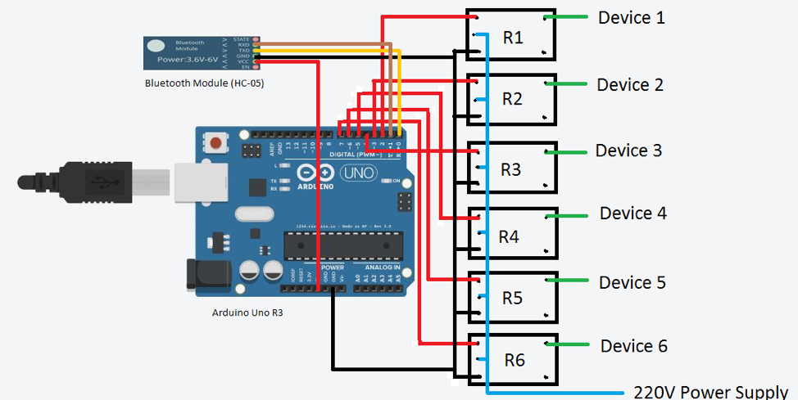
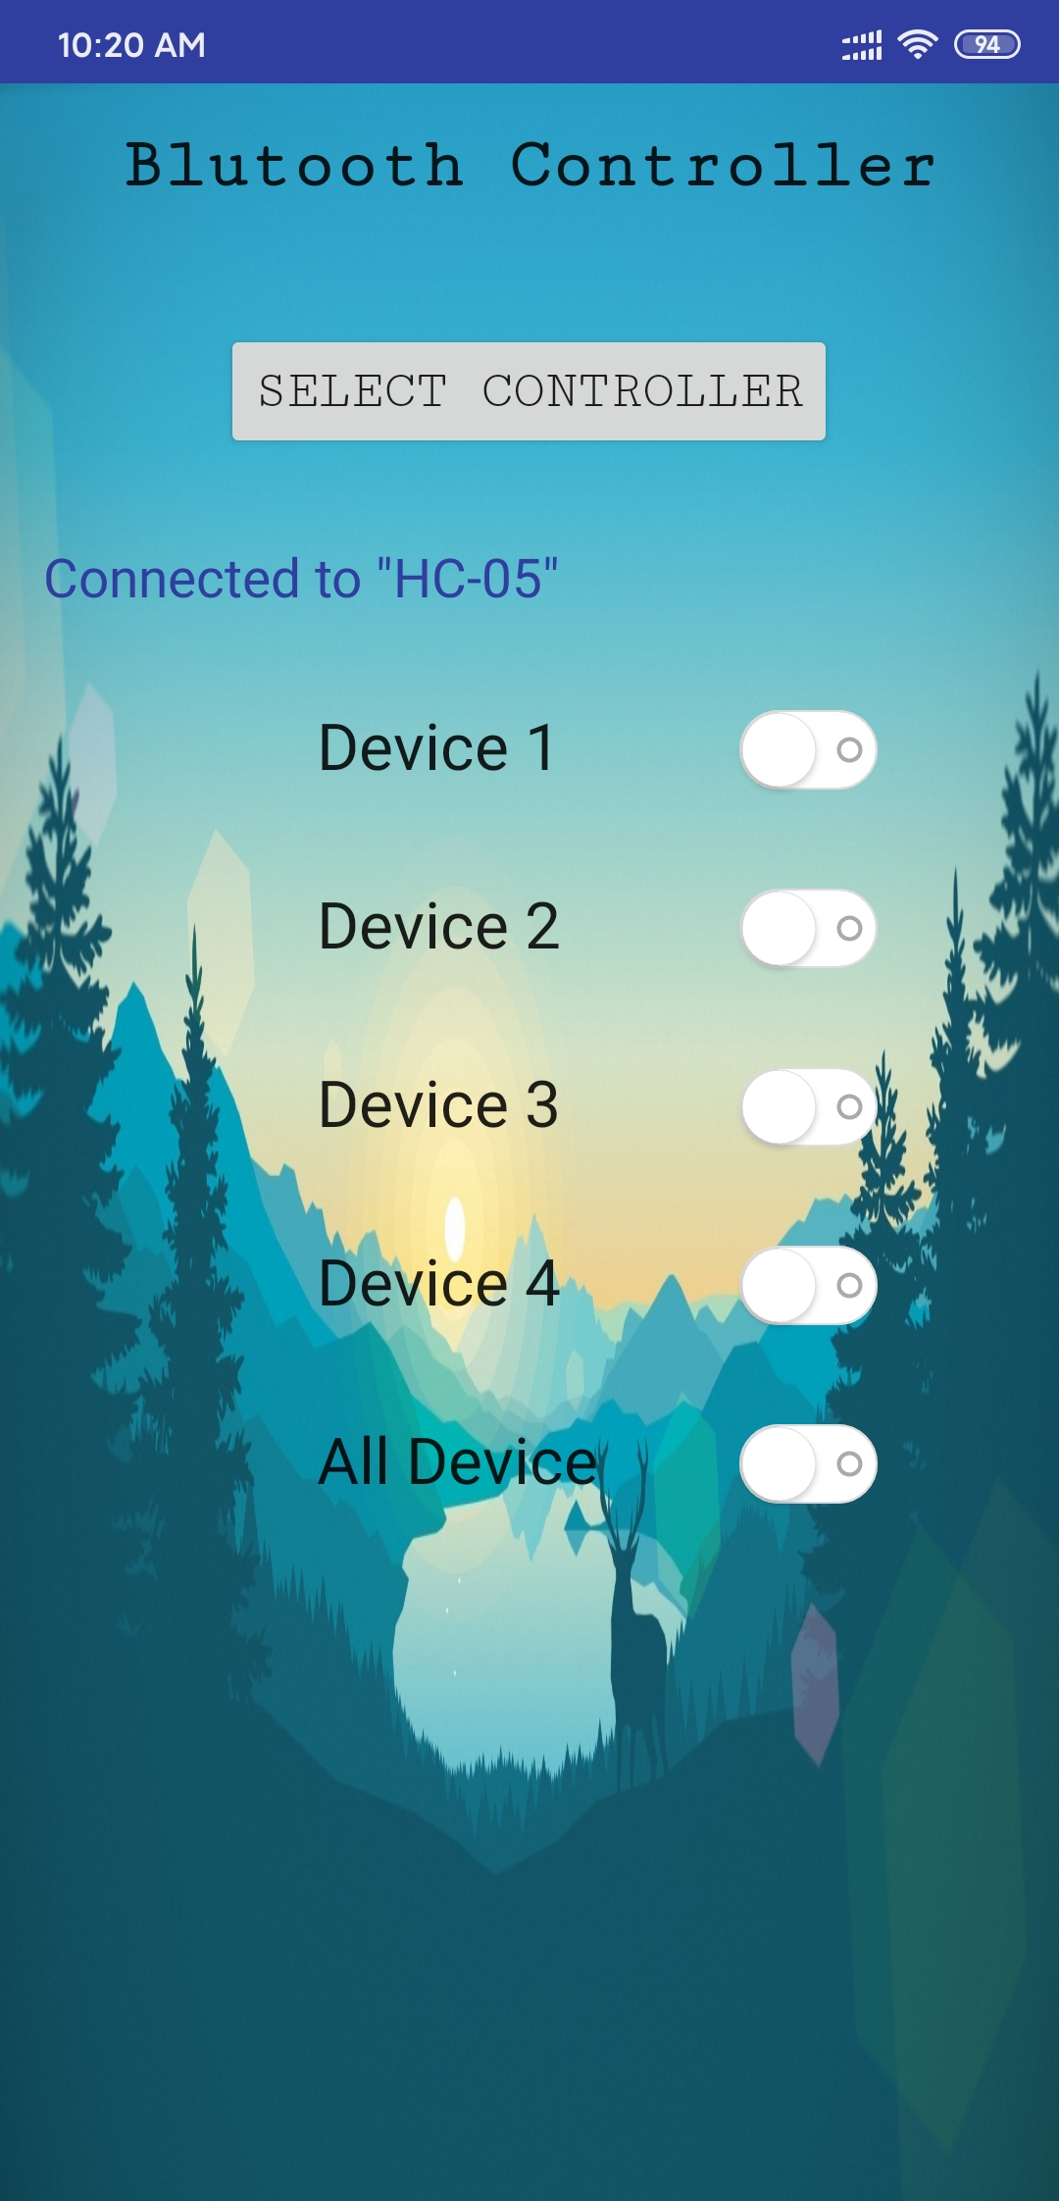
Circuit Diagrams :
Place your screenshot here

